Slide 1
Second stage of labor and perineal laceration prevention
Shaghayegh Moradi
Assistant professor of OB & GYN
1402/11/14

Slide 2
Vaginal delivery is the natural delivery process after the pregnancy period, and is the preferred mode of delivery for most mothers
The second stage of labour had a modest effect on postpartum pelvic floor function.

Slide 3
Interpretation of labor progress is based on the stage and phase:
First stage: The time from onset of labor to complete cervical dilation.
Second stage: The time from complete cervical dilation to fetal expulsion.
Third stage: The time between fetal expulsion and placental expulsion.
Fourth stage: commonly defined as the first hour or two after placental expulsion when the uterus begins the process of involution.

Slide 4
the pain during childbirth and the long labor duration causes not only physical fatigue of the puerpera but also many adverse psychological emotions, such as fear and anxiety of a potential perineum tear, thereby affecting the normal force of the puerpera during labor, prolonging the labor duration and increasing the amount of labor bleeding

Slide 5
The continuous exertion of the mother during the second stage of labor puts pressure on the perineal body locally.
If the labor process is prolonged or the fetus is stuck during the delivery after entering the pelvis, the risk of episiotomy or tearing of the perineum will be increased, and even worse, there is an increased risk of suffocation and dystocia for the newborn

Slide 6
The pelvic myofascia is subjected to orthostatic pressure for several months during pregnancy.
During labor, persistent tension and contraction of pelvic floor muscle fibers cause spasms, and the fascial matrix transmits the tension produced by the muscle, resulting in increased fascial tension and ischemia

Slide 7
The incidence of perineal trauma has been reported to be up to 85%, with the most common being first or second-degree lacerations (perineal skin only, and perineal skin and muscles, respectively). Rates of third-degree lacerations, involving the anal sphincter, and fourth-degree lacerations, involving the sphincter and anal epithelium, vary in reports secondary to differences in classification and reporting.

Slide 8
Second stage :
The statistical maximum duration (95th percentile) for the second stage also differs by parity:
•Nulliparous patients: 2.9 hours
•Parous patients: 1.1 hours

Slide 9
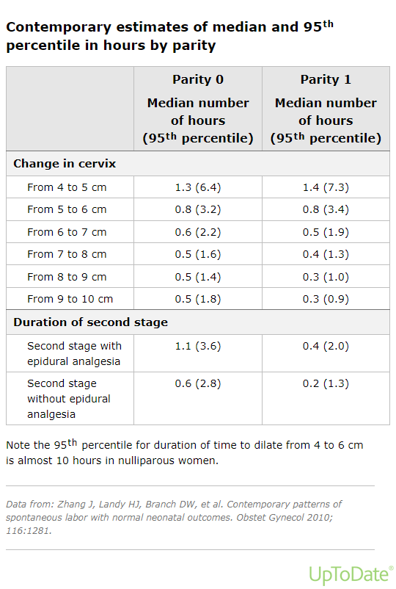

Slide 10
Ultrasound :
Ultrasound cannot be used to measure cervical dilation without the use of special equipment.
Although not widely used clinically, it can document fetal position and descent, the presence and extent of caput, and rotation (when performed serially) in the second stage. For assessing fetal position and station
It appears to be more objective and reproducible than digital examination.

Slide 11
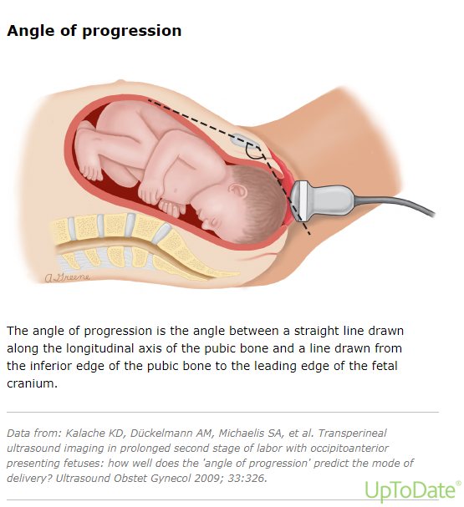

Slide 12
When the ultrasound is performed at the beginning of the second stage, this technique may be used to predict the likelihood of spontaneous vaginal birth. In a meta-analysis (8 studies, 887 pregnancies), AoPs from 108 to 119 degrees yielded the highest sensitivity (94 percent) and AoPs from 141 to 153 degrees yielded the highest specificity (82 percent) for predicting spontaneous vaginal birth.

Slide 13
Another approach is to measure the head to perineum distance (HPD) serially to assess descent over time; however, station cannot be determined because the HPD measurement does not account for the curvature of the birth canal. In a study of nulliparous patients in spontaneous labor at term, HPD of 30 mm and AoP 125 degrees each predicted birth within three hours (95% CI 2.5-3.8 hours and 2.4-3.7 hours, respectively) in those who went on to have a vaginal birth .

Slide 15
Non-occiput anterior position: The length of the second stage appears to correlate with the degree of rotation away from occiput anterior (OA).
●Diagnosis: The diagnosis can be made digitally, but ultrasound is more accurate . Many fetuses actually enter labor in either OP or OT position and then undergo spontaneous rotation to OA during labor.
Protraction and arrest disorders associated with malposition occur when rotation to OA does not occur or is slow to occur during labor.

Slide 16
Cephalopelvic disproportion:
A disproportion in the size of the fetus relative to the maternal pelvis can result in failure to progress in the second stage and has been termed cephalopelvic disproportion (CPD).
This may be due to fetal malposition (eg, extended or asynclitic fetal head, occiput posterior [OP] or transverse position) or malpresentation (mentum posterior, brow) rather than a true disparity between fetal size and maternal pelvic dimensions.
These factors may result in reduced force from the fetal head to the cervix, which has been associated with a protracted labor course. However, true CPD may occur if the fetus has a large surface anomaly (eg, teratoma, conjoined twin), the maternal pelvic anatomy is not conducive to fetal passage or is deformed (eg, after pelvic trauma), or the fetus is extremely large

Slide 17
Diagnosis:
CPD is a subjective clinical assessment based on physical examination and course of labor. It usually manifests as a prolonged second stage but may manifest as failure of the head to engage. In a small prospective study of nulliparous patients in active labor, a floating head (station ≥-3) at 7 cm dilation was predictive of eventual cesarean birth in 100 percent of cases
Clinical and radiologic assessments of the maternal pelvis and fetal size (ie, pelvimetry) are inexact and poorly predict the course and outcome of labor, except at the extremes of pelvic contraction or excessive fetal size. Radiographic pelvimetry is not recommended because it exposes the fetus to ionizing radiation without being informative

Slide 18
Approach to episiotomy
Episiotomy is the surgical enlargement of the posterior aspect of the vagina by an incision to the perineum during the last part of the second stage of labor. The incision is performed with scissors or scalpel and is typically midline (median) or mediolateral in location

Slide 19
PREVALENCE AND RISK FACTORS
While rates of episiotomy have declined over time, the optimal rate and indications have not been established.
●Declining rates :global rates of episiotomy generally declined.

Slide 20
●Unclear goal rate or indications
●Factors impacting episiotomy rates : Factors that impact episiotomy rates include parity, insurance coverage, geographic location, and type of practice (private versus academic).

Slide 21
Parity
Insurance and geography – In a study from a United States insurance database, episiotomy was more common in patients with commercial insurance . Hospital factors including rural location or academic center were associated with reduced rates of episiotomy. The WHO notes that episiotomy is more common in middle-income countries that have increasing access to healthcare but are still in transition.

Slide 22
Private practice
Risk reduction – In a trial including nearly 500 laboring patients, perineal massage and warm compresses reduced episiotomy rates and second degree perineal lacerations compared with usual management.
While pelvic floor muscle training during pregnancy has been shown to reduce the risk of third- and fourth-degree lacerations, the rate of episiotomy was not impacted

Slide 23
LACK OF ADVANTAGES FOR EPISIOTOMY USE:
Routine use of episiotomy is no longer recommended,
restrictive episiotomy resulted in up to 30 percent fewer women sustaining severe perineal or vaginal trauma.

Slide 24
●Reduction of trauma to the fetal head
●Ease of repair and improved wound healing

Slide 25
Preservation of the muscular and fascial support of the pelvic floor
●Prevention of anal sphincter laceration – There is increasing consensus that the median episiotomy is not effective for this purpose and, in fact, has been associated with an increased rate of severe perineal lacerations.

Slide 26
Prevention of shoulder dystocia – In a systematic review of 14 studies including over 9700 cases of shoulder dystocia, only one study evaluated the effect of episiotomy on prevention of shoulder dystocia, and the result was not significant. While episiotomy does not appear to prevent shoulder dystocia, its use in the management of shoulder dystocia is less clear.

Slide 27
ADVERSE OUTCOMES OF EPISIOTOMY:
●Extension of the incision, leading to third- and fourth-degree tears, particularly for median episiotomy.
●Risk of unsatisfactory anatomic results (eg, skin tags, asymmetry, fistula, narrowing of introitus).
●Increased blood loss .
●Higher rates of infection and dehiscence.
●Increased risk of severe perineal laceration in subsequent deliveries .
●Patient fear – The WHO issued a State of Inequality report in 2015 that notes that a "fear of cutting" with episiotomy and cesarean birth may result in women avoiding deliveries in healthcare facilities. WHO suggests that avoidance of routine episiotomy use in low- and middle-income countries may improve healthcare equality and increase rates of deliveries in healthcare facilities

Slide 28
WHEN TO CONSIDER EPISIOTOMY:
The decision to perform episiotomy is heavily dependent on the opinion of the delivering clinician and is based on the clinical scenario at the time of delivery . There are no specific situations in which episiotomy is essential. It is a reasonable option when the clinician believes enlarging the birth outlet to facilitate delivery of the fetus will benefit the mother or baby and warrants maternal exposure to the potential adverse outcomes associated with the procedure.

Slide 29
●Expedite delivery of the fetus –a category III fetal heart rate tracing that does not respond to resuscitative measures. Episiotomy is only helpful if delivery is being blocked by perineal tissue (ie, episiotomy will not improve maternal expulsive efforts
●Operative vaginal delivery – Episiotomy can be used to facilitate placement of the forceps or vacuum extractor in women with a narrow vaginal outlet.
multiple societies advise against routine episiotomy with operative vaginal delivery
When episiotomy is performed, mediolateral episiotomy is associated with a lower risk of anal sphincter injury compared with median episiotomy.

Slide 30
Shoulder dystocia :
In some cases of shoulder dystocia, performing an episiotomy can increase space for the operator's fingers and thus facilitate delivery of the posterior shoulder and other internal procedures, but does not appear to prevent shoulder dystocia or release the impacted anterior shoulder. Routine use of episiotomy to manage shoulder dystocia is not advised until more data from randomly assigned trials are available to determine the balance of benefit or harm. Episiotomy does not prevent shoulder dystocia.

Slide 31
PROCEDURES AND SELECTION: The most common types of episiotomy are the median (midline) and mediolateral
Mediolateral versus median (midline) episiotomy — Consistent with the World Health Organization (WHO), our preference is a mediolateral episiotomy because it does not increase the risk of an anal sphincter laceration (ie, third- or fourth-degree obstetric injury) as does the median episiotomy

Slide 32
Median episiotomy is associated with a higher risk of anal sphincter laceration than mediolateral episiotomy .
Mediolateral episiotomy is associated with increased blood loss
mediolateral episiotomy has historically been thought to result in more perineal pain and dyspareunia
Median (midline) — The median episiotomy starts within 3 mm of the midline of the posterior fourchette and extends downwards between 0 and 25 degrees of the sagittal plane. The median episiotomy is more commonly performed in the United States.

Slide 33
Mediolateral — The mediolateral episiotomy begins within 3 mm of the midline in the posterior fourchette and is directed laterally at an angle of at least 60 degrees from the midline towards the ischial tuberosity. The mediolateral episiotomy is more commonly used in Europe.

Slide 34
●Lateral episiotomy – The lateral episiotomy includes the mediolateral angulation but the incision starts off-center between 7 to 8 o'clock or 4 to 5 o'clock rather than at the traditional 6 o'clock position. This adjustment seeks to reduce the risks associated with an intended mediolateral episiotomy with fetal crowning and ultimately becomes more similar to a midline episiotomy when suturing

Slide 35
Timing — A reasonable approach is to perform the procedure when the delivery of the fetus is anticipated within the next three to four contractions. The optimal time for cutting the episiotomy is not known.
Procedure — Prior to performing an episiotomy, the clinician will typically place one or two fingers inside the posterior vaginal wall to protect the fetal scalp during incision. The incision is performed with either scissors or scalpel.

Slide 36
Delivery and repair — During delivery of the fetal head, support of the perineum at the most interior aspect of the incision may help reduce extensions.
Following delivery of the fetus and the placenta, a thorough examination of the perineum, including a rectal examination, is performed to determine extent of the incision and any further lacerations or extensions that might warrant repair.

Slide 37
COMPLICATIONS:
Common complications of episiotomy include extension of the incision deeper into the perineum or the anal sphincter complex, infection, postpartum pain, and dyspareunia. Although vulvovaginal hematomas can occur after episiotomies, this complication is rare.

Slide 38
IMPACT ON FUTURE DELIVERIES: Episiotomy use at the time of first vaginal delivery appears to increase the risk of a severe obstetric laceration in a subsequent vaginal delivery.
Logistic regression modeling predicted a fivefold increased risk of anal sphincter complex lacerations for women with prior episiotomy.
Although the type of episiotomy was not identified in this study, the majority of episiotomies were likely median incisions as these are most common in the United States, where the study was performed.

Slide 39
COST-EFFECTIVE CARE: There is little information regarding the impact on health care costs associated with episiotomy use.
Costs that could be impacted include the procedure itself,
repair of any laceration extensions,
postpartum pelvic floor physical therapy,
more frequent postpartum visits for evaluation of healing with advanced lacerations,
and remote complications including dyspareunia and/or fecal incontinence.

Slide 40
PREVENTION: There is no strong evidence that any intervention will prevent a prolonged second stage of labor. The following interventions have been studied.

Slide 41
Maternal position and technique – Neither maternal pushing position nor technique (eg, physiologic versus coached) appears to have a substantial effect on the length of the second stage, although an upright position for delivery may shorten the second stage by 3 to 10 minutes
Physical activity/exercise:
Pelvic floor muscle exercises
•Exercise
•Continuous labor support

Slide 42
PUSHING:
Early versus delayed
ACOG recommends that patients begin pushing when the cervix becomes completely dilated to reduce the risk of adverse outcomes from delayed pushing.

Slide 43
Breathing/pushing technique — In our practice, we advise patients to bear down when they feel the need (ie, spontaneous pushing or physiologic pushing), unless neuraxial anesthesia has inhibited the bearing down sensation. Although a common practice is to tell parturients to pull back their knees, tuck in their chin, take a deep breath, bear down at the start of a contraction, and push for 10 seconds with the goal of three pushes per contraction, there is no strong evidence that coaching individuals in this way has any benefit or harm compared with allowing them to bear down and push according to their own reflex needs in response to the pain of contractions and the pressure felt from descent of the fetal head.

Slide 45
Conclusions:
anal sphincter injury risk factors:
forceps delivery,
maternal obesity
advanced age were associated with higher odds of anal incontinence

Slide 47
Conclusions:
Both episiotomy and severe perineal tear are risk factors for LAM avulsion and anal sphincter injury,
this can be useful for identifying women who are at greater risk of developing PFM dysfunctions.

Slide 49
Conclusion:
Antenatal exercise could reduce the duration of the second stage of labor with racial differences. It effectively and significantly reduces the duration of the first and second stages of labor in China, and West Asia, however it shows no effect in Europe and Brazil. Exercise also does not reduce perineal lacerations and number of analgesia requests by women.

Slide 51
Conclusion:
Antenatal PFME may be effective at shortening the second stage of labour and reducing severe perineal trauma.
These findings need to be interpreted considering the included studies’ risk of bias. More high-quality RCTs are needed.

Slide 53
Conclusions:
Massage during the second stage of labor appears to be effective in preventing episiotomies and reducing the duration of the second stage of labor.
However, it does not appear to be effective in reducing the incidence and severity of perineal tears

Slide 55
Conclusions:
hands-on technique during spontaneous vaginal delivery of singleton gestations results in a similar incidence of several perineal trauma compared to the incidence with the hands-off technique. The incidence of third-degree lacerations and of episiotomy is increased with the hands-on technique. Given no benefit, and potential harm, associated with the hands-on technique, we suggest caution in its use.

Slide 57
Conclusions:
The second stage of labour > 2 h increased the incidence of SUI at 6 weeks postpartum and decreased PFM endurance for 1 year.

Slide 59
Conclusions:
Prolonged second stage of labor increased the risk of 5 min Apgar score<7 and admission to the Neonatal Intensive Care Unit in nulliparous and multiparous women, without increasing the risk of neonatal death.
This review demonstrates that prolonged second stage of labor increases the risk of neonatal complications in nulliparous and multiparous women.

Slide 61
Conclusions:
The available evidence does not show the squatting position during childbirth to be beneficial. As there is no evidence for or against squatting, women should be able to choose the position they prefer.

Slide 63
Conclusions:
The results revealed that perineal massage with Ostrich oil could be recommended as an effective, safe, and inexpensive method to improve the rate of episiotomy in vaginal delivery. Perineal massage can be performed by midwives in the first and second stages of labor.

Slide 65
Conclusions:
The effects of the use of lubricant have been unclear and is still subject of debate. The lubricant is a substance introduced to reduce friction, applied on the perineal area and/or in the vaginal canal with or without an applicator. Gel could work through a purely physical effect, reducing the opposite force to vaginal childbirth. Our meta-analysis provides evidence that the use of lubricant gel during labor does not reduce the length of labor or improve maternal or neonatal outcomes.

Slide 67
Conclusions:
Antenatal perineal massage reduces the incidence of episiotomy, third- and fourth-degree perineal tears, postpartum perineal pain, and anal incontinence. It also leads to a shorter second stage of labor, better wound healing, and improvement in Apgar scores. Thus, healthcare professionals should consider and recommend antenatal perineal massage as a routine practice for labor preparation.

Slide 69
Conclusions:
Breathing exercise is an effective complementary preventive intervention in shortening the duration of the second stage of labour. With the adverse consequences associated with amniotomy, oxytocin and CS, complementary therapies could facilitate a favourable delivery experience.

Slide 71
Conclusions:
There is evidence of widespread, ongoing use of manual uterine fundal pressure during labour in health facilities internationally. This procedure currently has no evidence of benefit, and has the potential to cause harm to women and their babies. Efforts to prevent this unnecessary practice should be implemented through development of relevant and evidence-based policies, health professional training, use of audit and feedback, and quality improvement initiatives. Addressing the ongoing use of uterine fundal pressure using these approaches is an important step in optimizing intrapartum care for all women

Slide 73
Conclusions:
Conclusion: The second stage duration was reduced in cases of a flexible sacrum birthing position. Even though the reduction in duration varies across studies with considerable heterogeneity, laboring women should be encouraged to choose her comfortable birth position. Researchers who aim to compare different birthing positions should consider study designs which enable women to choose birthing position.

